Slide 1
Quality review
Prototype Design(Web-based management)

Slide 2
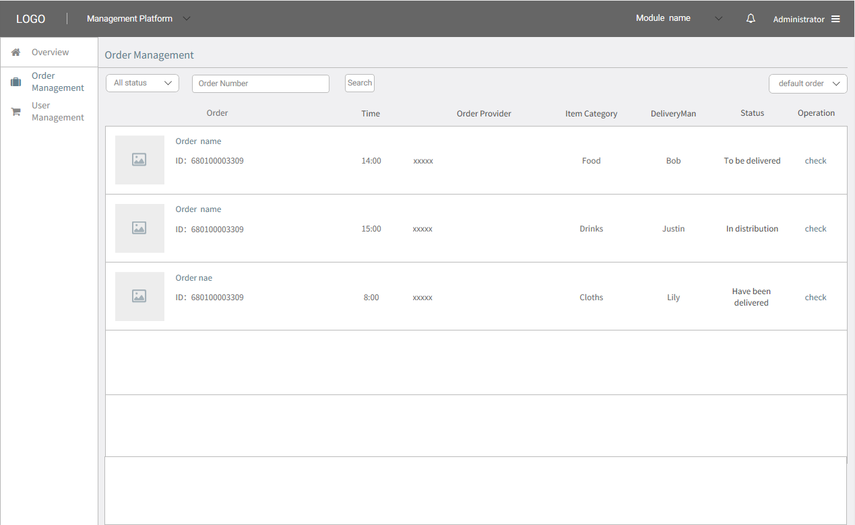
Prototype Design(Web-based management)

Slide 3
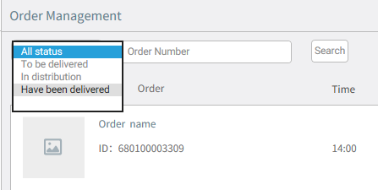

Slide 4
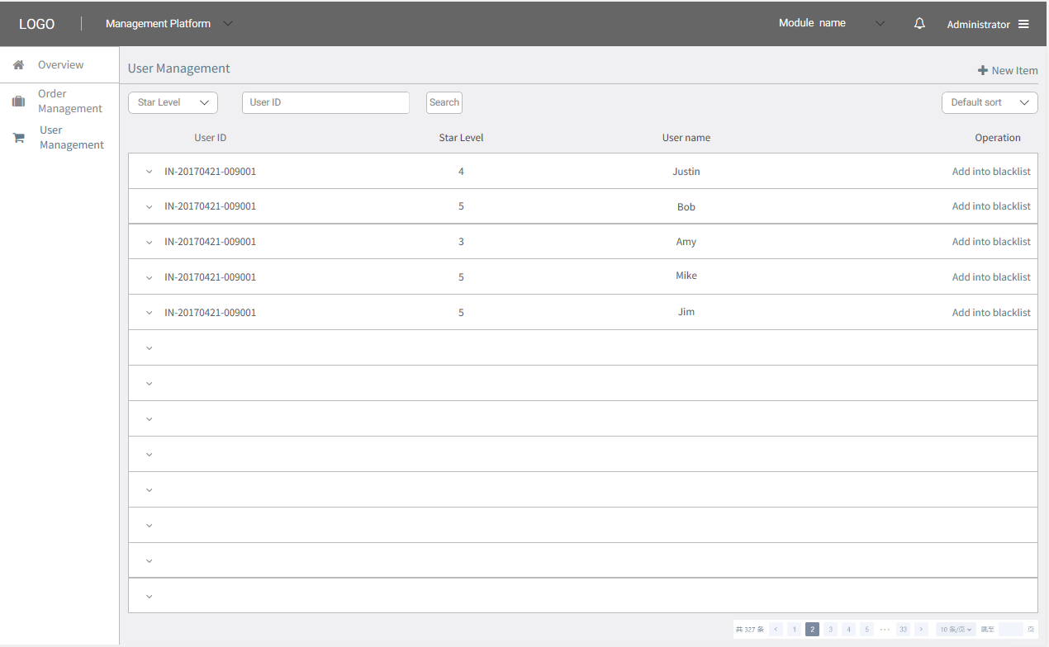

Slide 5
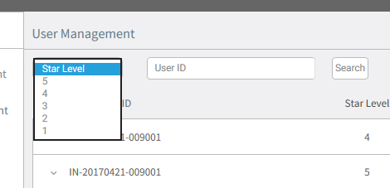

Slide 6
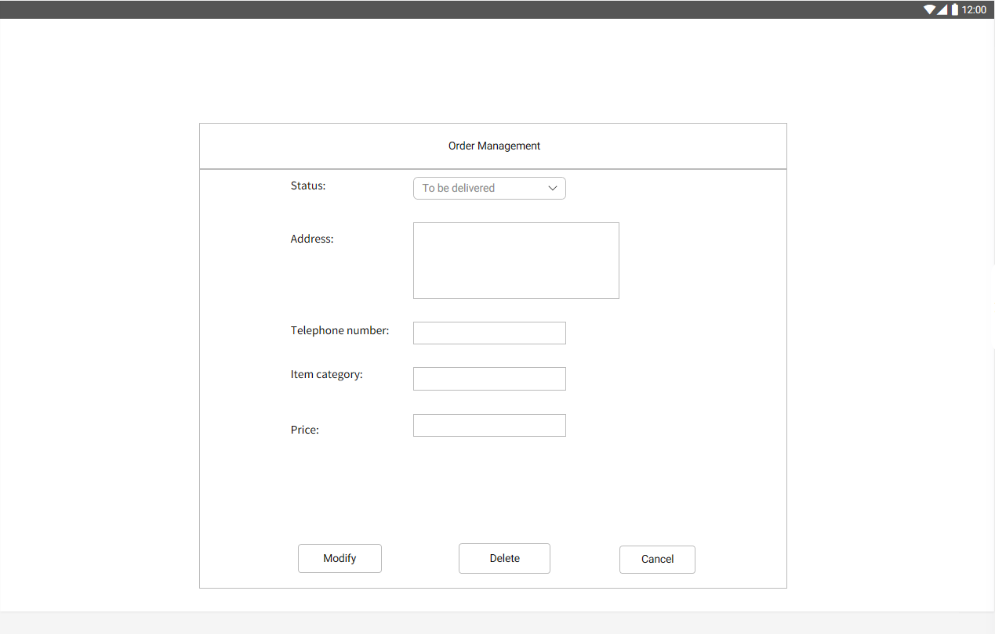

Slide 7
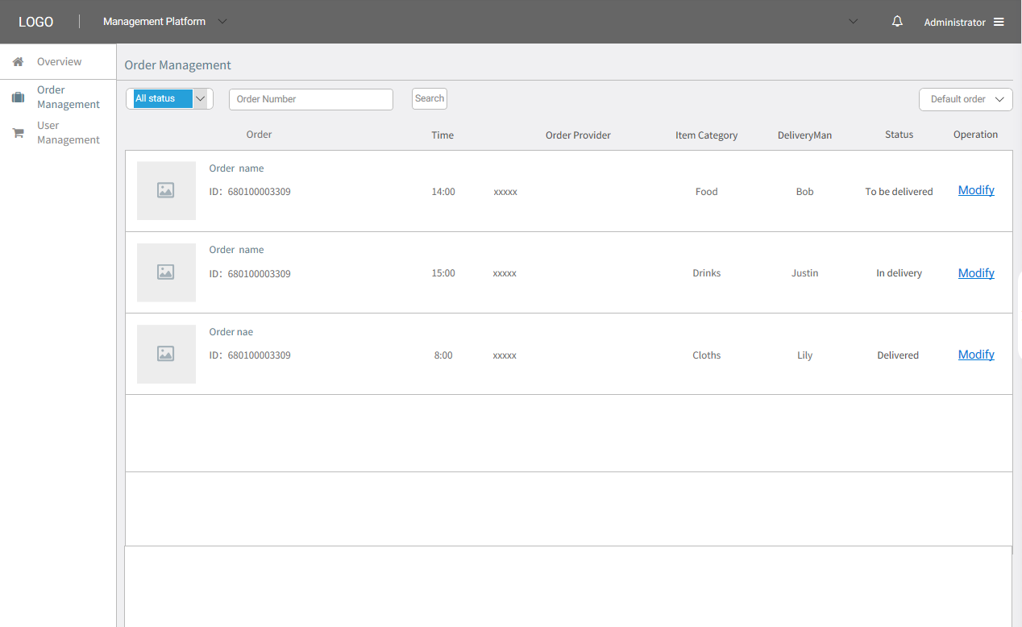

Slide 8
Thanks for your time
Prototype Design(Web-based management)

